Slide 1

Team Details
Team name : CAMSAFE SQUAD
Team leader name : ENIYA VK
Problem Statement : OPEN INNOVATION

Slide 2


SMART HIDDEN CAMERA DETECTION AND ALERT SYSTEM!
(a small step towards safer private spaces and digital privacy)
PROBLEM STATEMENT: SOLUTION:
Rising incidents of hidden A Software system to
Survelliance in many spaces. detect cameras easily.
Cameras are miniaturized, Sends instant alerts upon
Hard to detect manually. Suspicious detection.
Also leads to safety risks. Empowers users to
protect safety.

Slide 3

OPPORTUNITY:
a. How different is it from any of the other existing ideas?
b. How will it be able to solve the problem?
a. b.
1.End to End Automation Autonomous detection
No scanning needed. Identifies hidden camera
2.Software Centric Design Real time Response
Works without hardware Instant alerts on threat .
3.Adaptive Intelligence Privacy Assurance
Uses learned patterns Gives user safety.

Slide 4





GOOGLE TECHNOLOGY
Used in the solution
WHY GEMINI?
Smart Pattern Analysis
Focused on a camera detection .
AI-Based Visual Understanding
Enables easier to detect and gives alerts.
Handles complex Environments
Works well in low-light,real-world conditions.
Real time Accuracy
Shows context-aware accuracy to users.

Slide 5
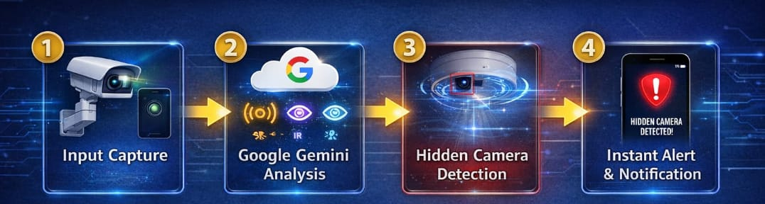



PROCESS FLOW DIAGRAM
CAPTURED DATA - Camera and sensor data are collected.
ANALYSED OUTPUT - AI analyses visual signals.
DETECTION- Identifies any suspicious,hidden camera in real life.
ALERTS- User receives an alert on their devices.

Slide 6
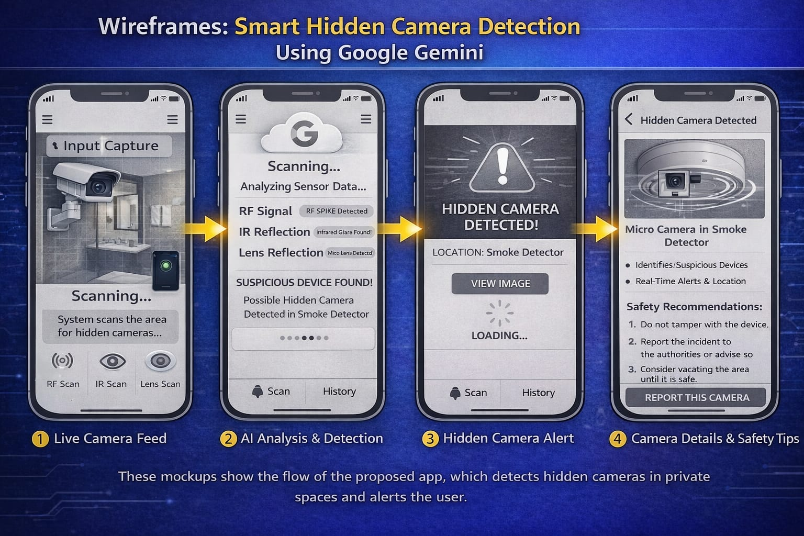
WIREFRAMES OF THE PROPOSED SOLUTION

Slide 7

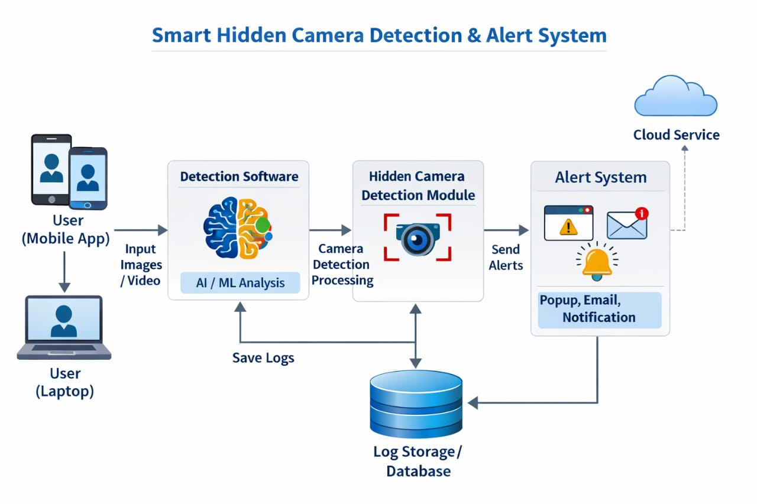
ARCHITECTURE DIAGRAM OF THE PROPOSED SOLUTION
( real-time detection and alerts)
Tech Stack: Python , OpenCV.
Detection &Processing Layer
User Layer
Alert and Storage layer
Image/Video Input
Detection Result

Slide 8





FUTURE DEVELOPMENTS OPPURTUNITIES
Enhanced AI Algorithms.
Adaptive ML based pattern recognition
GPS Tracking ,location mapping
Precise geospatial localisation
Cloud Storage &remote access
Encrypted cloud-based data storage
User Friendly Mobile app
Centralized system control interface

Slide 9
Provide links to your:
GitHub Public Repository
Demo Video Link (3 Minutes):https://drive.google.com/file/d/1dDf2mT-Ceg4ISY_ZIRw8AqiIXqpaH2Fn/view?usp=drivesdk
MVP Link

Slide 10

Thank you!

